Slide 1
Database

Slide 2
Brief History of the Relational Model
The relational model was first proposed by E. F. Codd in his seminal paper “A relational model of data for large shared data banks” (Codd, 1970).

Slide 3
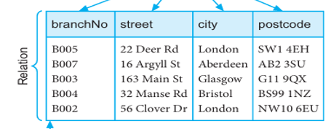
Relation
A relation = a table with rows and columns.
It represents a set of data about objects (e.g., Branches, Staff).
Order of rows or columns does not affect the meaning of the relation.
Logical structure only (external & conceptual levels), not physical.

Slide 4
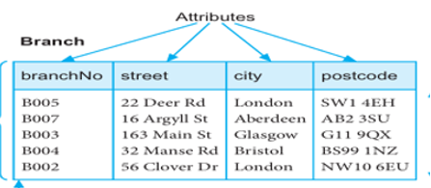
2. Attribute
An attribute = a named column of a relation.
Each column corresponds to a property of the entity.
Attributes can be in any order without changing the meaning.
Example:

Slide 5
3. Domain
A domain = the set of allowable values for an attribute.
Example
Branch No. values like B001–B999
Gender → Male/ Female
Salary-> monetary values in a defined range

Slide 6
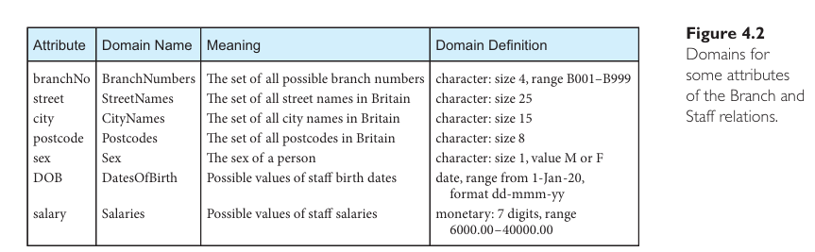
Example

Slide 7
4. Tuple
A tuple = a row of a relation.
Each tuple contains values for all attributes.

Slide 8
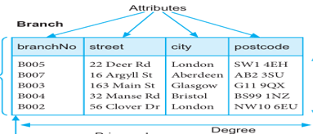
5. Degree
The degree = number of attributes in a relation.
Example: Branch has 4 attributes → degree = 4.

Slide 9
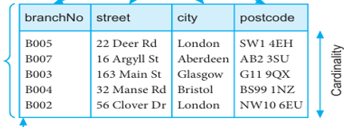
6. Cardinality
The cardinality = number of tuples (rows) in a relation at a given time.
Example: If Branch has 5 rows, cardinality = 5.
This changes dynamically as rows are added/deleted.

Slide 10
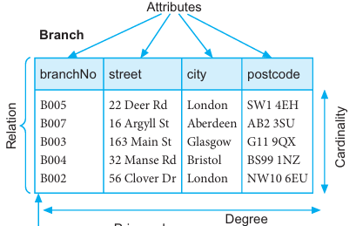

Slide 11
7. Relational Database
A relational database is built on the relational model. That means it is not just a random group of tables, but a set of well-structured relations that follow certain rules.
1. Collection of Relations
Each relation = a table with:
  Rows (tuples)
  Columns (attributes)
All relations in the database must have distinct names

Slide 12
Normalization is the process of organizing tables in a database
Stored only once (no repetition): Prevents storing the same fact in multiple places.
Consistent: If a fact changes (like a student’s phone number), you only update it in one place.
Easy to maintain: Avoids anomalies (errors like duplicate records, wrong updates, or missing values).
Improves integrity by enforcing rules between relations.

Slide 13
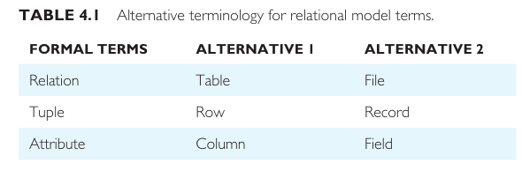
Alternative Terminology

Slide 14
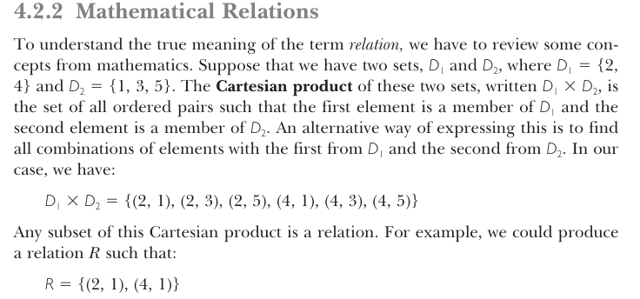
Mathematical Relations

Slide 15
Relation schema
A relation schema is like the structure of a table in a relational database.
It specifies:
Relation (table) name: the name of the table.
Set of attributes (columns) → what columns the table will have.
Each attribute’s domain (the set of allowable values).
Domain of each attribute: what type of values each column can store (like numbers, text, etc.).

Slide 16
Relational database schema
A relational database schema is like the overall design or structure of the entire database.
It is the collection of all relation schemas (all the tables and their structures) in that database.
Each relation schema must have a unique name, so tables don’t get confused with one another.

Slide 17
Properties of a Relation
A relation (i.e., a table in a relational database) must satisfy certain rules that come from mathematics (set theory). These ensure consistency and simplicity in the model.
1. Unique Name
Every relation has a distinct name in the database schema.
Example.
Branch, staff are unique relation names.

Slide 18
2. Each cell of the relation contains exactly one (single) value
Postcode = 75010 (valid)
Postcode = 75010, 75011 (not valid)
3. Distinct Attribute Names
Every attribute (column) must have a unique name within the relation.
Example
Branch No, city, post code

Slide 19
4. Same Domain for Attribute Values
All values in a column must come from the same domain.
Example:
Branch No: must always be branch numbers(B001-B999)
5. No Duplicate Tuples
Each row (tuple) must be unique in a relation.
Example
(B005, 22 Deer Rd,London, SW1, 4EH)can appear only once.

Slide 20
6. Order of Attributes Has No Significance
The arrangement of columns does not change the meaning of the relation.
7. Order of Tuples Has No Significance
Relations are sets of tuples → order does not matter.
Example: swapping the rows of branches B005 and B004 does not change the relation.

Slide 21
Relational Keys
A key is a special attribute (or a group of attributes/columns) in a relation (table) that is used to uniquely identify tuples (rows).

Slide 22
Super Key
Any set of attributes that can uniquely identify a tuple.
Example: In a Student(Student_ID, Name, Email, Phone) table:
Student_ID, Email, Phone
{Student_ID, Name}, {Student_ID, Email, Phone}
All are super keys because they can uniquely identify rows.

Slide 23
Super key
id | Name | email | Mobile number
1 | Ali | ali@gmail.com | 1234
2 | Fatma | Fatima@gmail.com | 2345
3 | Ahmed | Ahmed@gmail.com | 3456

Slide 24
Possible super keys
Id Unique for each student
Email Unique for each student
Phone Unique for each student
{ID, Name} Still unique (but has extra attribute, Name is not needed).
{ID, Email} Unique but contains extra attribute.
{ID, Name, Email, Phone} Unique but has all attributes (lots of extra).

Slide 25
Candidate key
Sometime a relation have more than one attribute that can uniquely identify each record in a table
Enrollment no. | Roll no | Name | class
Cy-024-01 | 1 | Ali | A
Cy-024-02 | 2 | Ahmed | B
Cy-024-03 | 3 | Mohammad | C
Cy-024-04 | 4 | Mohammad Ali | D

Slide 26
3. Primary Key
The chosen candidate key to uniquely identify tuples in a relation.
Must satisfy:
  Unique values.
  Not null (every tuple must have a value for the primary key).

Slide 27
Roll no is primary key
Roll No | Name | class
1 | Ali | A
2 | khan | B
3 | Ahmed | C
4 | Hassan | D

Slide 28
4. Alternate Key
The candidate keys that were not chosen as primary key.
Example
The selected attribute is called primary key
The candidate attribute that is not selected for primary key is called alternate key

Slide 29
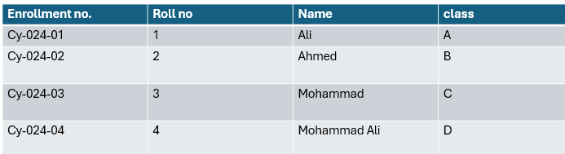

Slide 30
5. Foreign Key
An attribute (or set of attributes) in one relation that refers to the primary key in another relation.
Used to maintain referential integrity (relationships between tables).

Slide 31
PK
Foreign key
Roll no | Name | class
1 | Ali | A
2 | Ahmed | B
Roll no | subject | Marks
1 | English | 70
1 | Math | 80
2 | English | 75
2 | Math | 72

Slide 32
6. Composite Key
A key made of two or more attributes that together uniquely identify a tuple.

Slide 33
Roll No | Subject | Marks
1 | Information security | 80
1 | Database | 87
2 | Information security | 66
2 | Database | 88
3 | Information security | 77
3 | Database | 83

